Slide 1


WWT UNRAVEL 2025
“Personalized Recommendation System for Wings R Us – Maximizing Customer Delight & Order Value”
A Data-Driven, AI-Powered Cart Suggestion Engine Team YmiRa: Janani J Harish KV

Slide 2

Introduction & Problem Context
Key Points:
Wings R Us wants to personalize cart recommendations in their app to:
Increase basket size
Improve customer retention
Deliver fresh & relevant suggestions
Existing checkout experience = static & repetitive suggestions
Need for a data-driven, scalable, cross-platform solution.
Impact Opportunity:
Research shows personalized recommendations can improve AOV (Average Order Value) by 10–15% in QSR apps.

Slide 3

Problem Statement
Business Challenges:
Relevance Gap: Current suggestions often generic & repetitive.
Customer Variety: First-timers vs. loyal fans need different approaches.
Scalability: Manual curation isn’t feasible across 500+ items.
Testing Need: Must validate with a low-risk pilot before rollout.
Cross-Platform: Same experience on app, web, and kiosks.

Slide 4
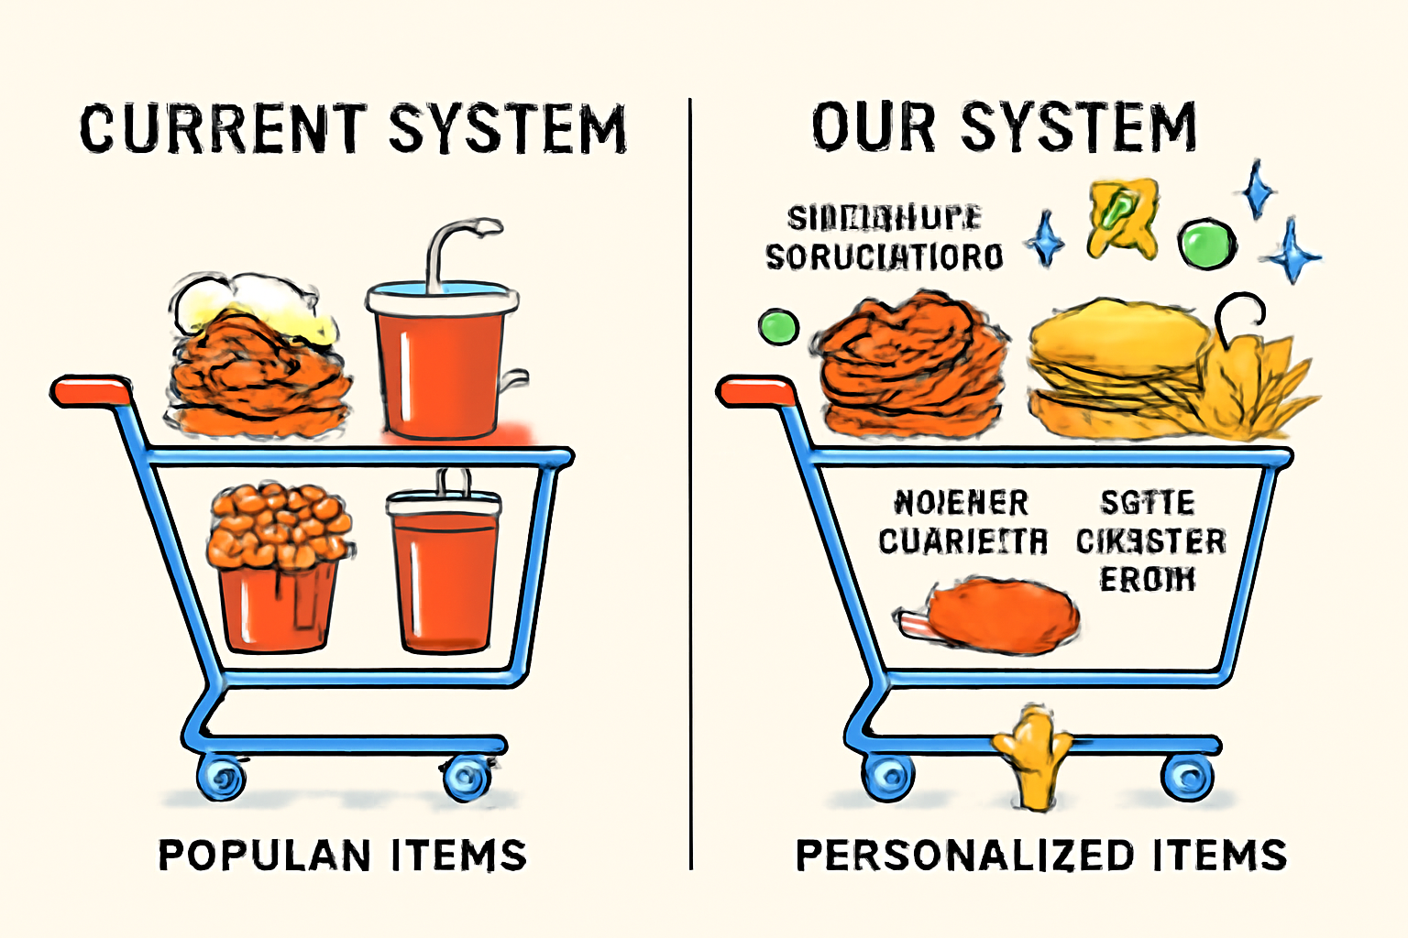
Existing Systems & Limitations
Common QSR Recommendation Methods:
Rule-based (e.g., If wings → suggest fries) → too rigid.
Global popularity lists → same items for everyone.
Manual seasonal promotions → labor-intensive.
Why they fail:
No personalization.
Poor freshness (repeats).
Lack of historical customer behavior integration.
No integration of:
Customer history
Order co-occurrence patterns
Freshness & variety logic

Slide 5
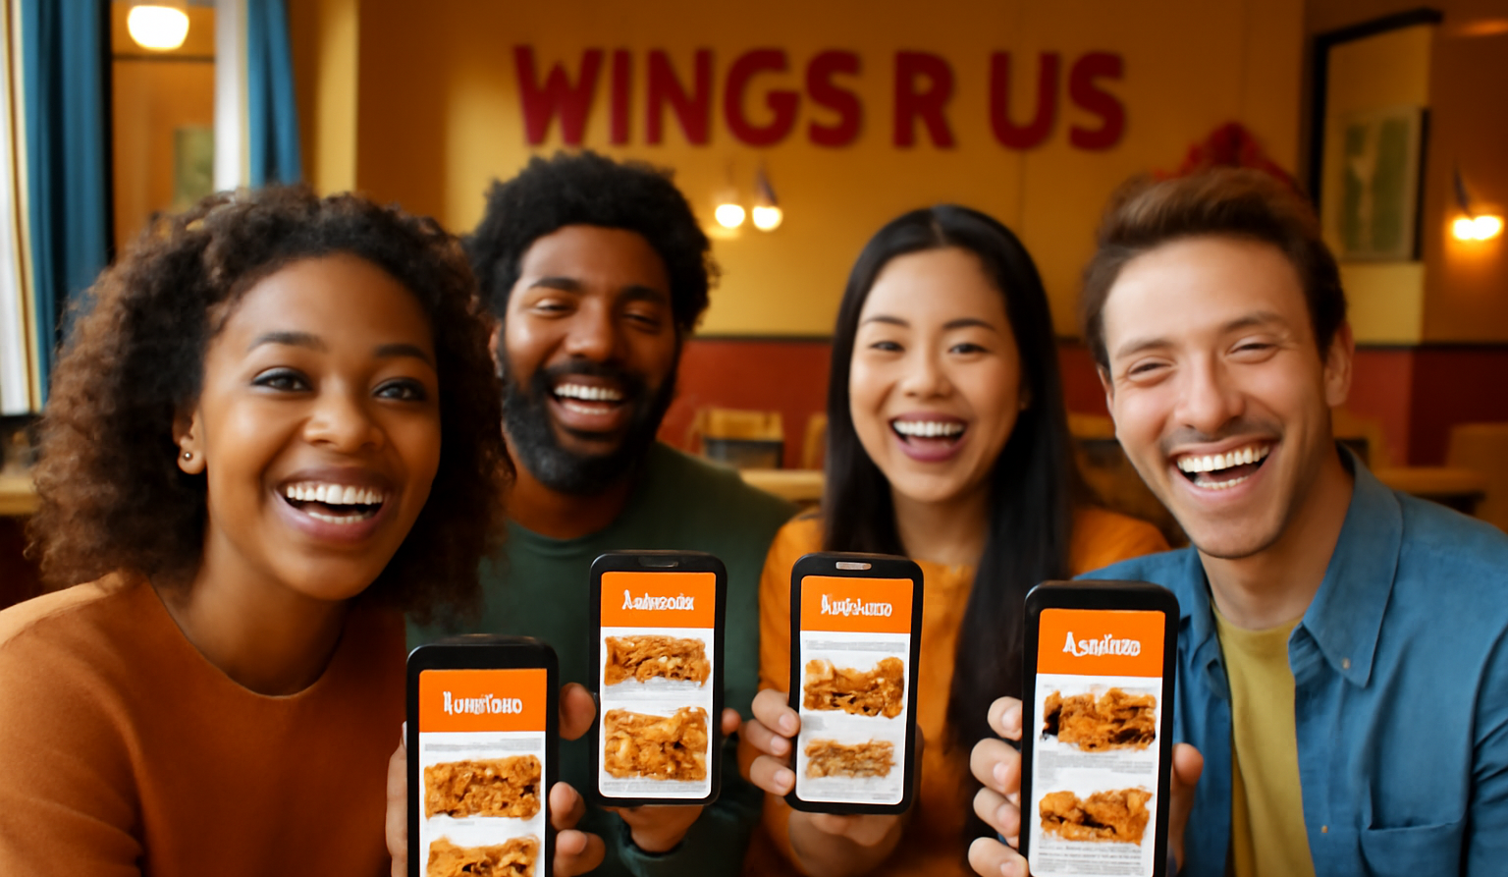
Our Solution: Hybrid Recommender
Approach: We built a Hybrid Recommendation Engine combining:
Item-to-Item Collaborative Filtering (Cosine Similarity on past orders)
Customer Profile Boosting (frequency-weighted personalization)
Popularity Fallback (handles cold-start users)
Freshness Filter (avoids repetition in recent orders)
Result: Dynamic, relevant, and customer-specific recommendations — in real time.
Core Idea: A Hybrid Item-to-Item Collaborative Filtering + Customer Profile Boost system.
Key Features:
Item–Item Similarity Matrix using cosine similarity on historical orders.
Customer Profile Boost to weight items based on personal buying patterns.
Popularity Fallback for cold-start & sparse data.
Freshness Logic to avoid repetitive recommendations.
Works seamlessly across platforms.

Slide 6
Technical Architecture
Pipeline:
Data Preprocessing: Extract orders → explode into transactions.
Item–Item Matrix: Build co-occurrence similarity using sparse vectors.
Customer Profiles: Store top historical items per user.
Recommendation Scoring:
Similarity score + Personal history boost + Popularity bonus.
Output Top 3 Recommendations to front-end API.

Slide 7

Key Technical Advantages
Hybrid Scoring: Outperforms pure collaborative filtering & popularity lists.
Personalization Layer: Leverages long-term customer memory.
Efficient Computation: Sparse matrix cosine similarity for speed.
Cross-Platform API: Single backend serving app, web, kiosk.
Variety Control: Freshness algorithm prevents boredom.

Slide 8
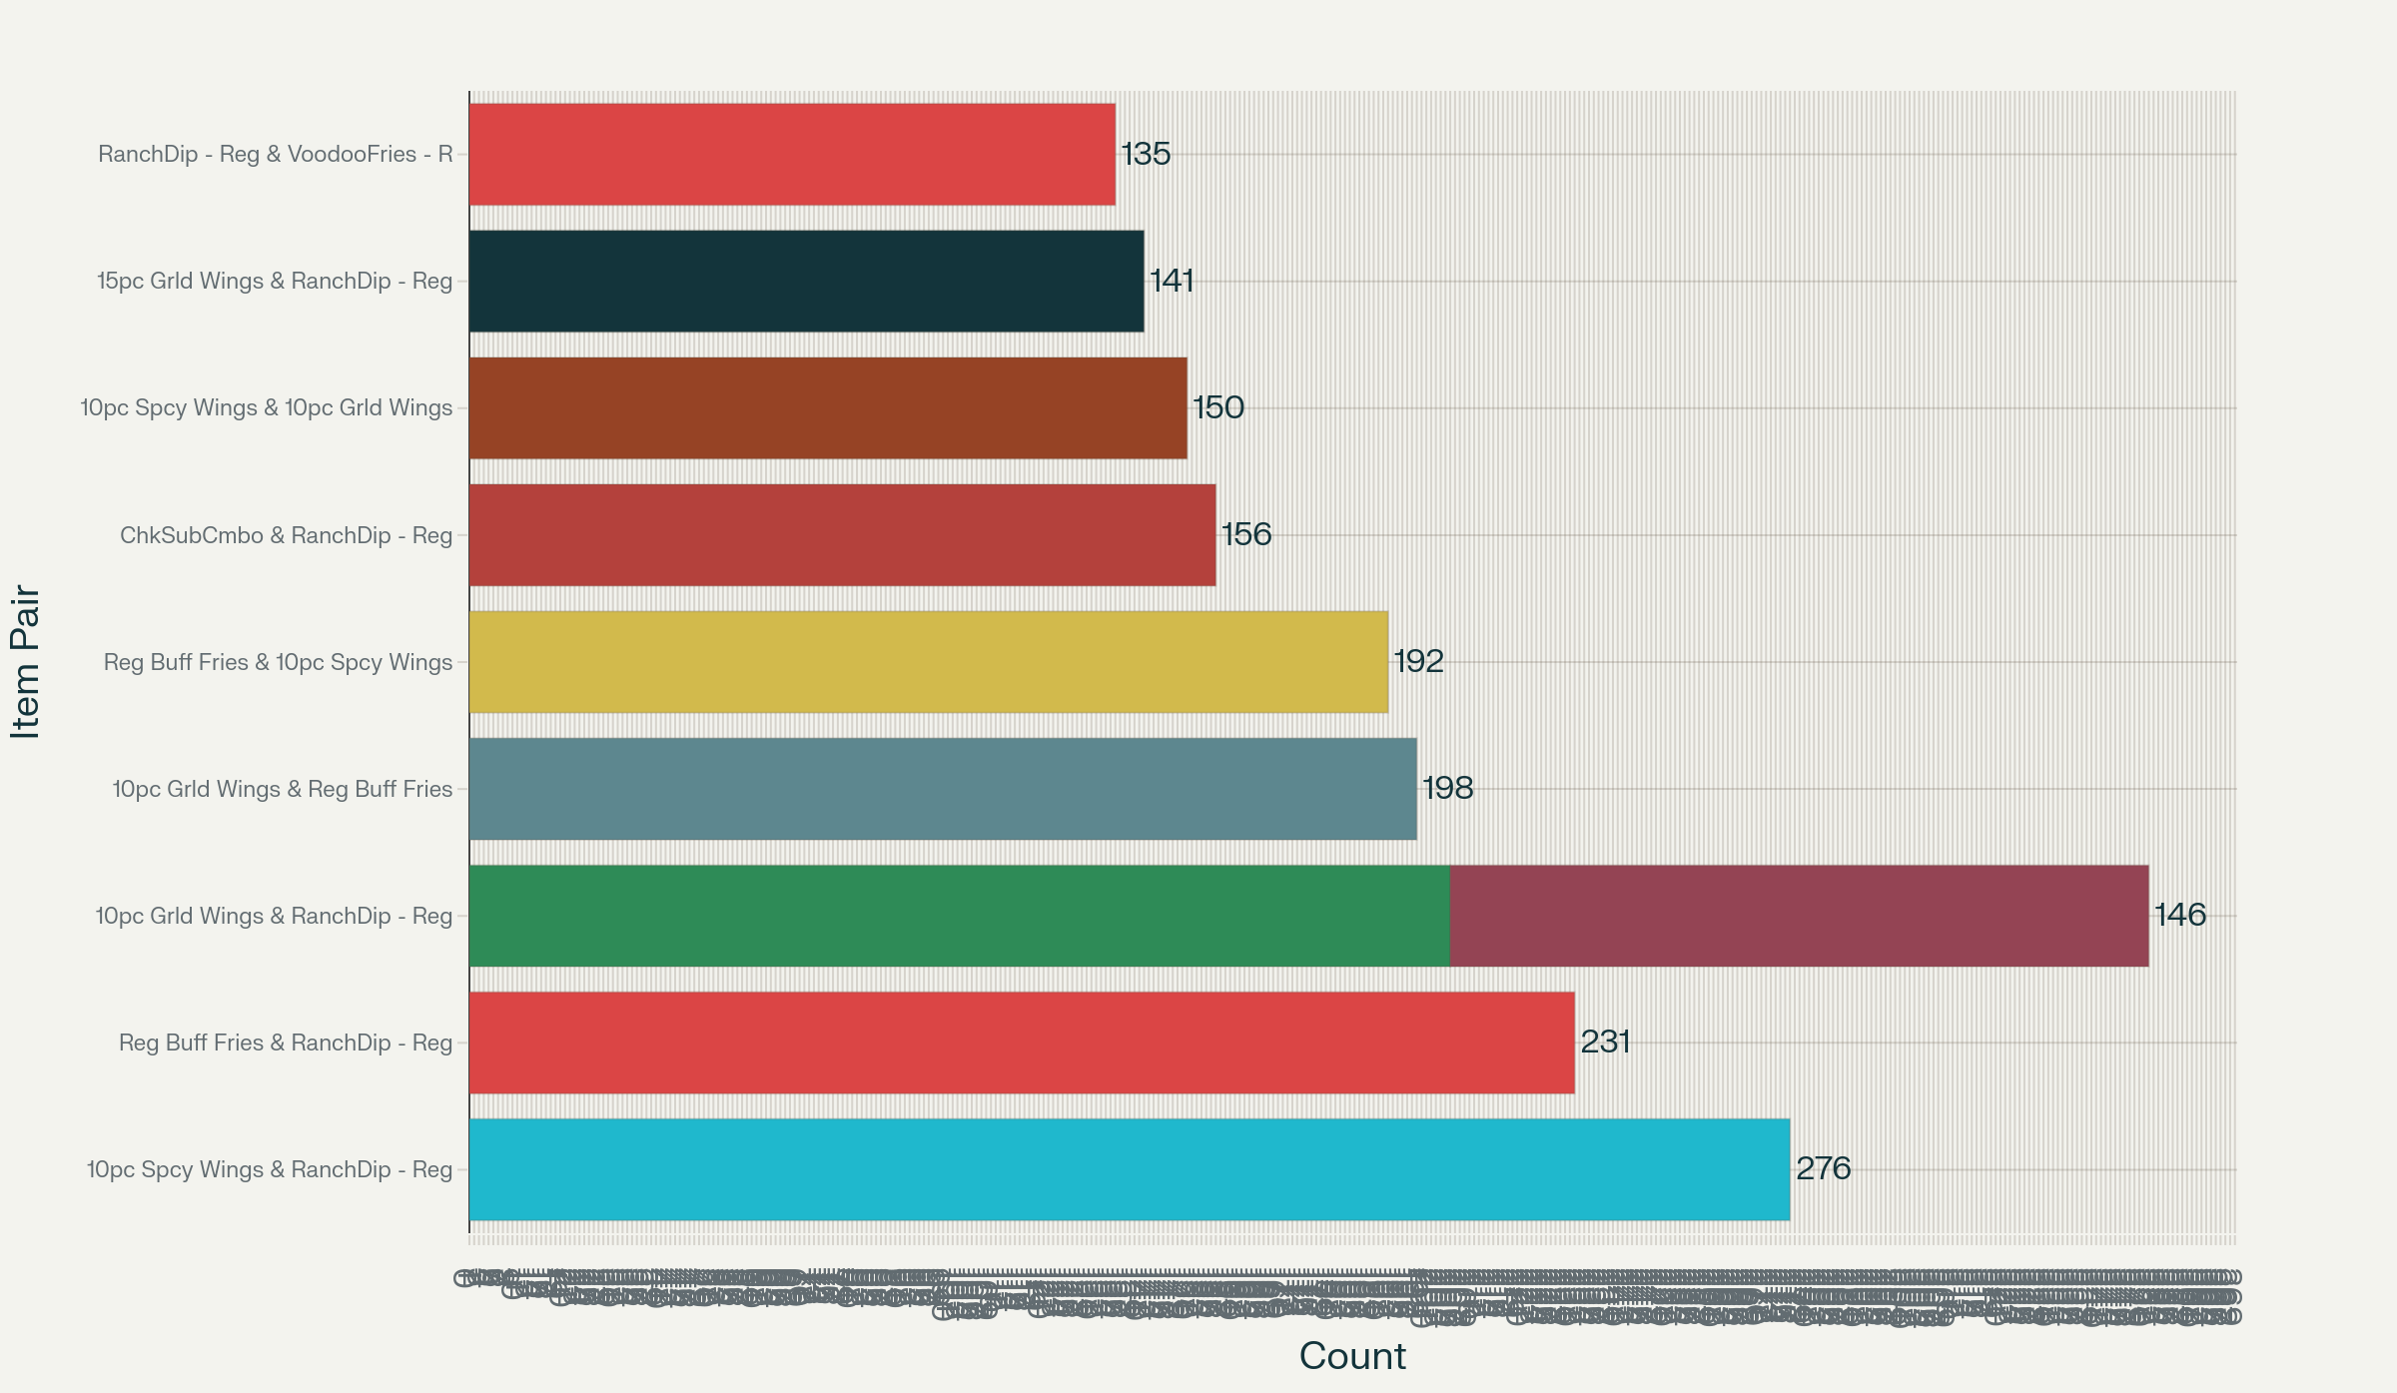
Simulated Test Insights
Data Sources Used:
1.4M historical orders
550k unique customers
38 store locations
Competition test set (1k customer carts with missing items)
Observed Patterns:
Top Co-Purchased Items: Wings + Soda, Wings + Fries, Combo Meals.
Customer Types:
40% Loyal Repeat Buyers
35% Registered Users
25% Guest Users

Slide 9

Business Impact & Pilot Plan
Benefits to Wings R Us:
Higher Basket Size → more revenue per order.
Better Customer Experience → higher retention & loyalty.
Operational Efficiency → automated, no manual curation needed.
Pilot Plan:
Deploy in one city for 4 weeks.
Measure: AOV, recommendation click-through rate, repeat order rate.
Scale to all stores if KPIs improve by ≥ 10%.

Slide 10
Conclusion & Next Steps
Summary:
We delivered a personalized, hybrid recommendation system.
Our approach outperforms static methods and scales easily.
Strong alignment with business goal: Boost AOV, improve CX.
Next Steps:
Pilot test deployment.
Integrate A/B testing for fine-tuning.
Add contextual signals (time of day, promotions).
"Personalization isn’t just technology — it’s how Wings R Us can make every order feel like it was made just for the customer."

